Slide 1

Certified Kubernetes Developer

Slide 2
Intro
Online performance based exam
Not multiple choice
Online proctor will be watching you during exam
Kubernetes documentation - https://www.cncf.io/certification/ckad/
https://www.cncf.io/certification/candidate-handbook
https://www2.thelinuxfoundation.org/ckad-tips

Slide 3
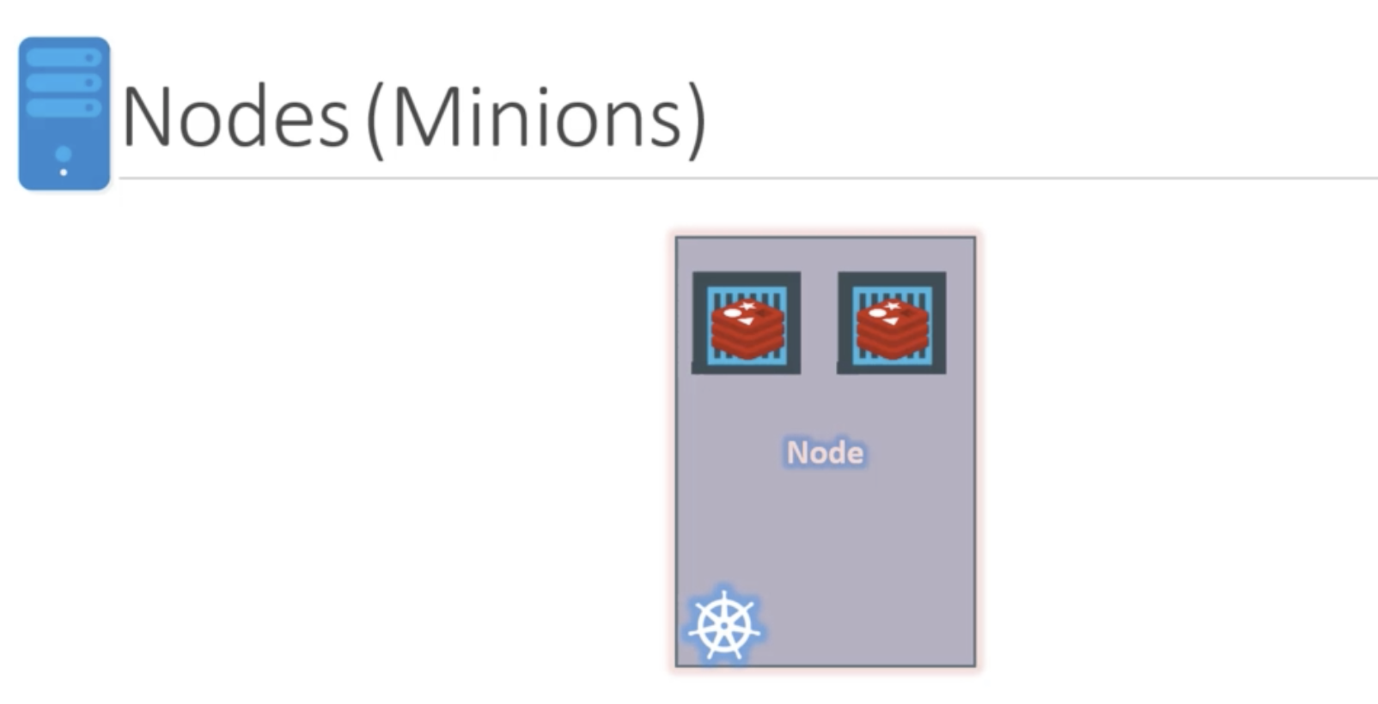
Core Concepts
Nodes –
is a machine (physical or virtual) on which k8s is installed
Is a worker machine where containers are launched by k8s
Also known as minions in the past

Slide 4
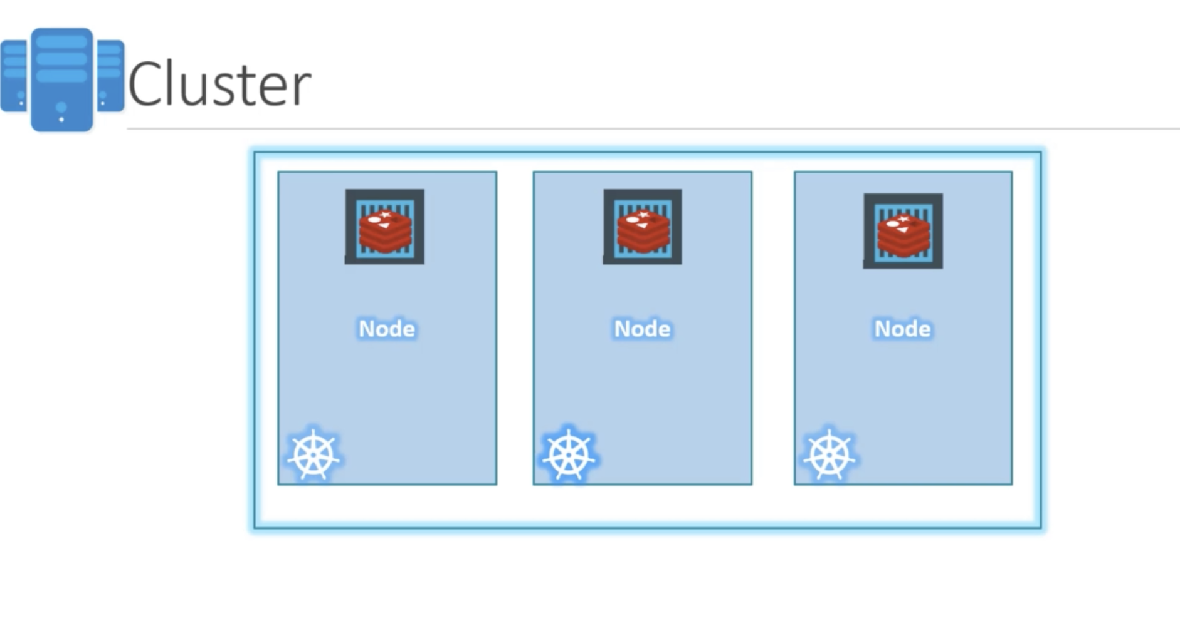
Core Concepts
Clusters
has multiple nodes
helps share load
If one node goes down availability is maintained

Slide 5
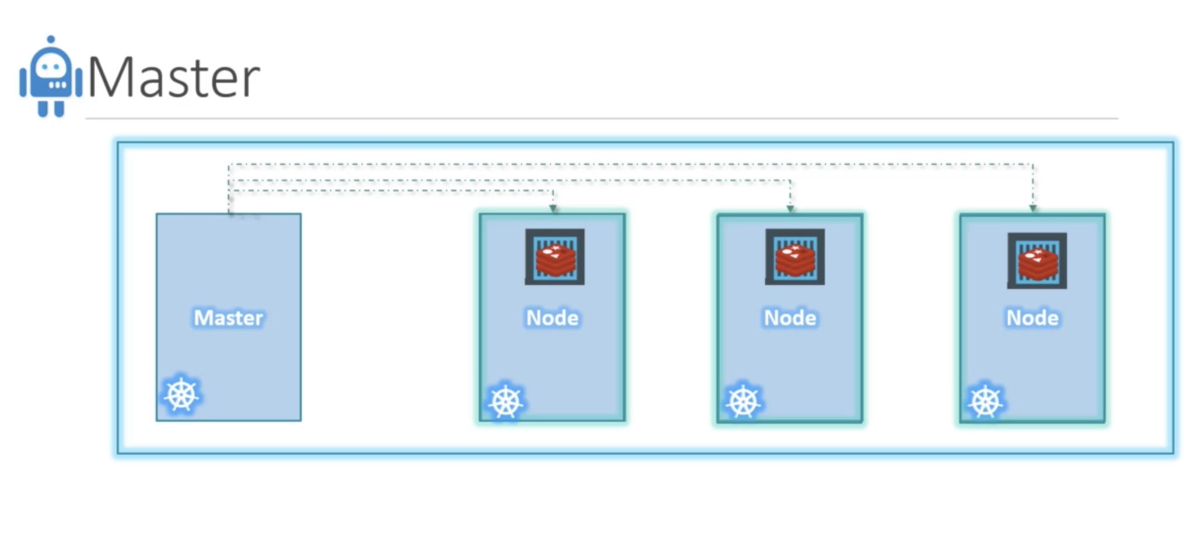
Core Concepts
Master
Watches over nodes in cluster
Manages orchestration of nodes in cluster

Slide 6
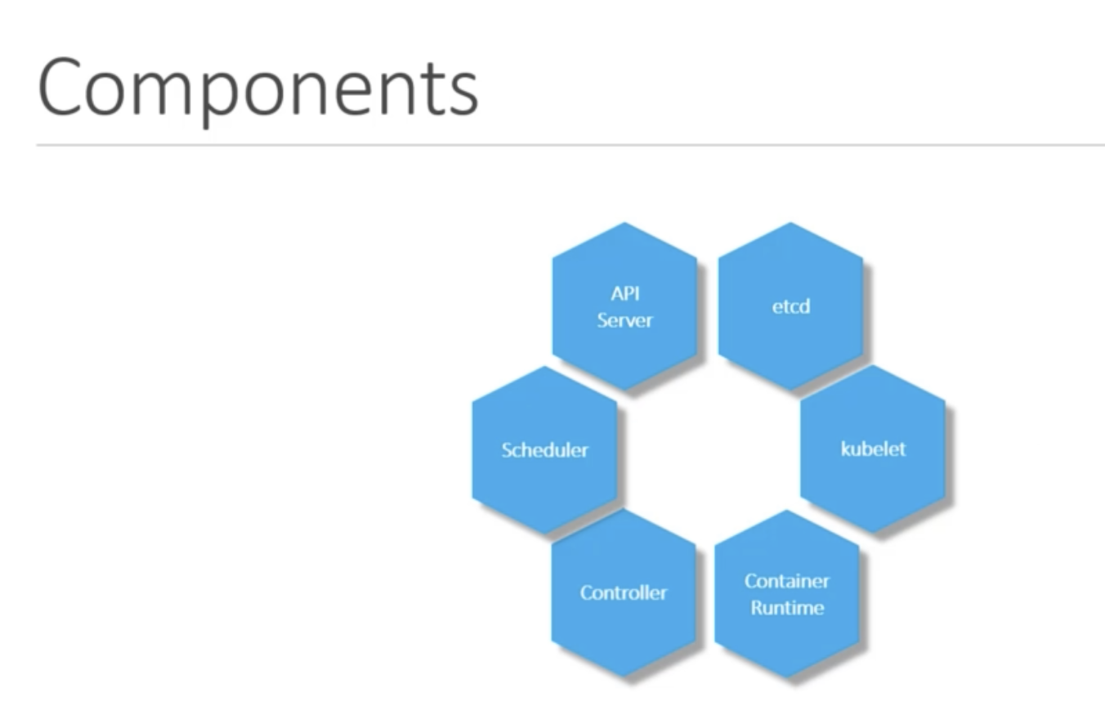
Components

Slide 7
Components
API server – clients hit the server
Etcd – key value store
Scheduler – keeps schedule of all nodes
Controller – brain behind deciding whether to create new containers etc.
Container runtime – containerization software for e.g. docker
Kubelet – agent that checks if containers are running

Slide 8
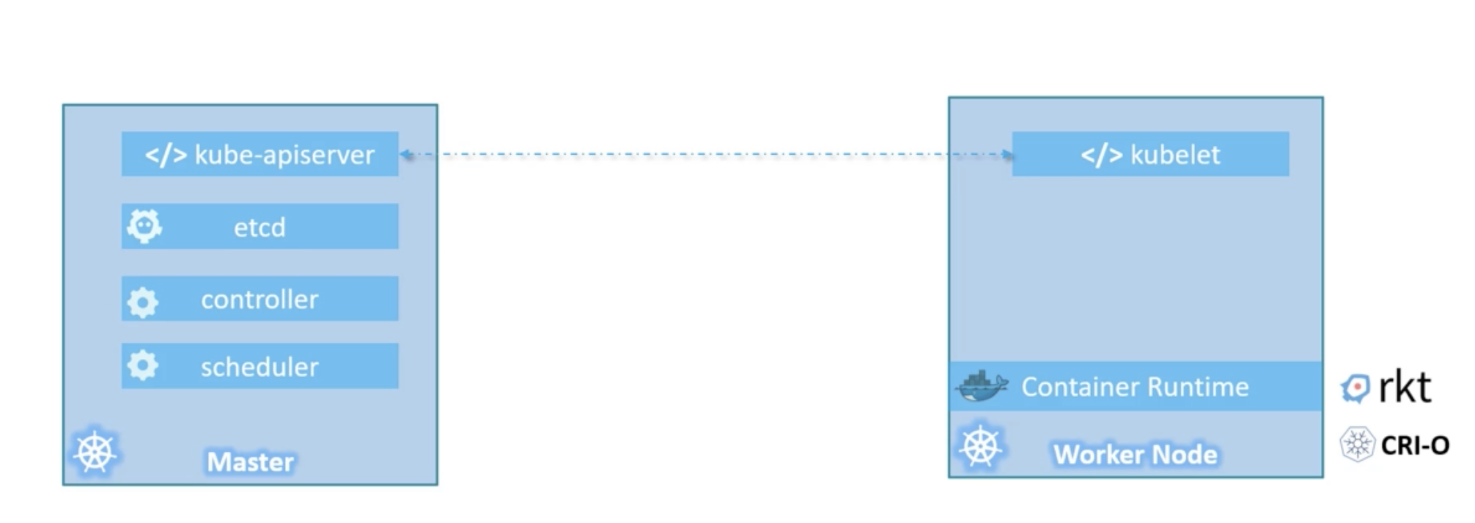
Master VS Worker nodes

Slide 9
Master VS Worker
Master has:
API server
etcd
Scheduler
Controller
Worker has:
Kubelet agent
Container run time (docker)
Sends health info to master

Slide 10
kubectl
CLI
Kubectl run command is to deploy app in cluster
Kubectl cluster-info is to get cluster info
Kubectl get nodes and get nodes in the cluster

Slide 11
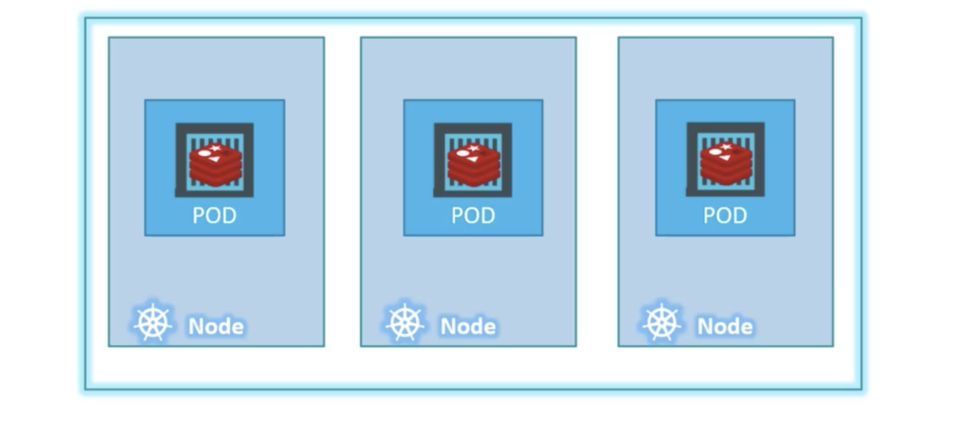
PODS
K8s does not deploy apps to containers in worker nodes, they are encapsulated in PODs
It uses PODs to deploy apps – single instance of an app
Smallest object you can create in k8s

Slide 12
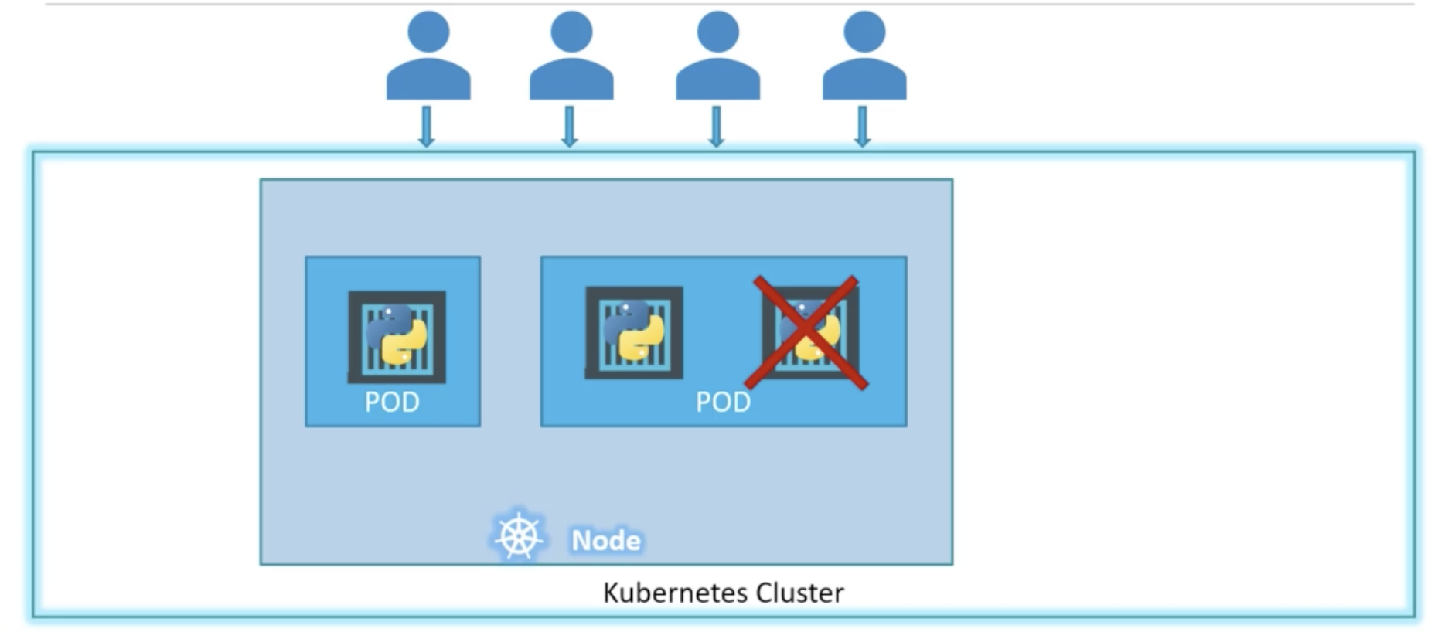
PODs
PODs usually have 1 – 1 relationship with app
Scale by adding new PODs in nodes
OR create more nodes with PODs within them

Slide 13
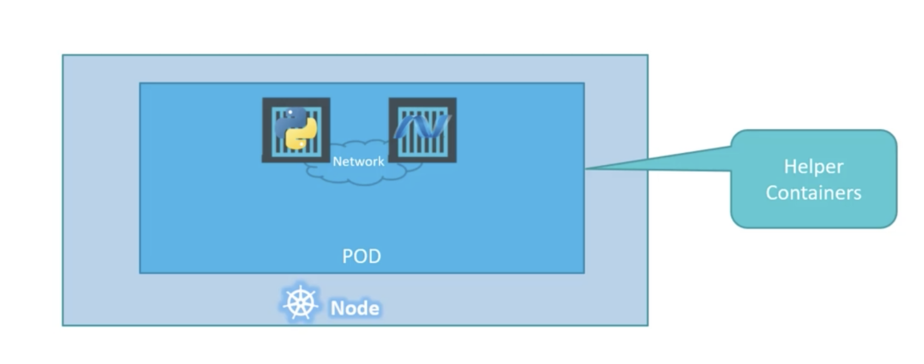
Multi-container PODs
You can have more than one container in a POD for a different purpose for e.g. helper containers
Why? – for convenience in networking and managing lifecycle dependencies easily

Slide 14
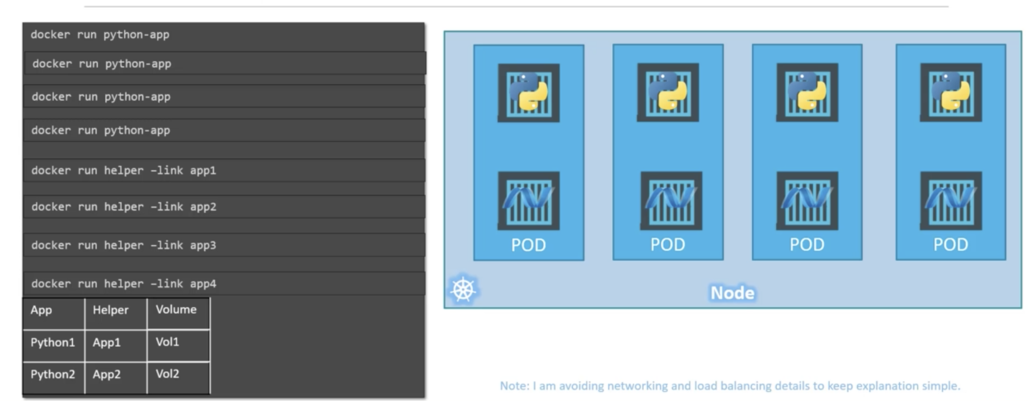
Why PODs?
PODs handle container creation patterns and volume attachments and fate automatically. Otherwise we would have to manage it automatically

Slide 15
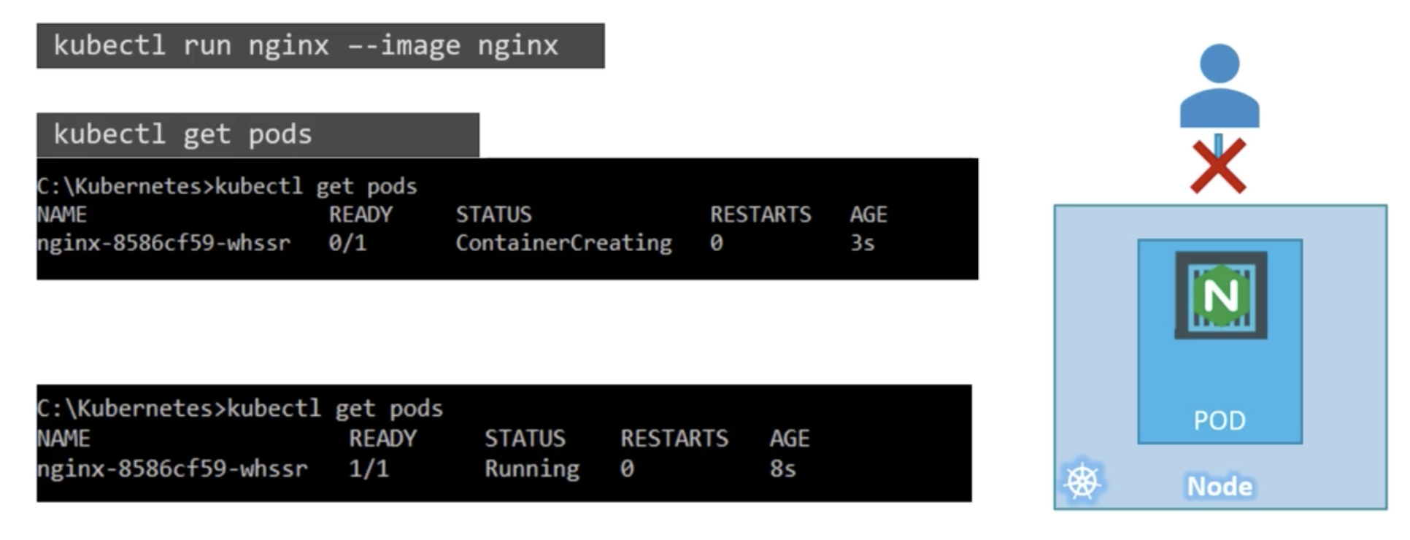
Example - NGINX
Deploy NGINX on a POD

Slide 16
PODs using YAML
Pod-definition.yml
Root level properties (required)
apiVersion (version of k8s)
kind: POD, replicaset, service, deployment
Metadata: in form of dictionary
Spec:
Containers – list/array

Slide 17
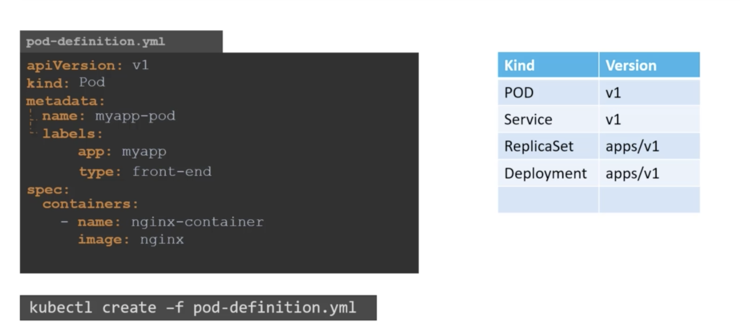
PODs using YAML

Slide 18
POD commands
Kubectl get pods
Kubectl run nginx –image=nginx
Kubectl describe pod nginx (detailed description)
Kubectl create –f pod-file.yml
Kubectl apply –f pod-file.yml
Kubectl get pods –o wide (table format)

Slide 19
Editing existing PODs
When pod definition file does not exist, extract it out:
kubectl get pod <pod-name> -o yaml > pod-definition.yaml
Edit existing pod:
kubectl edit pod <pod-name>
Existing pod definition file:
Edit the file and create new pod using it

Slide 20
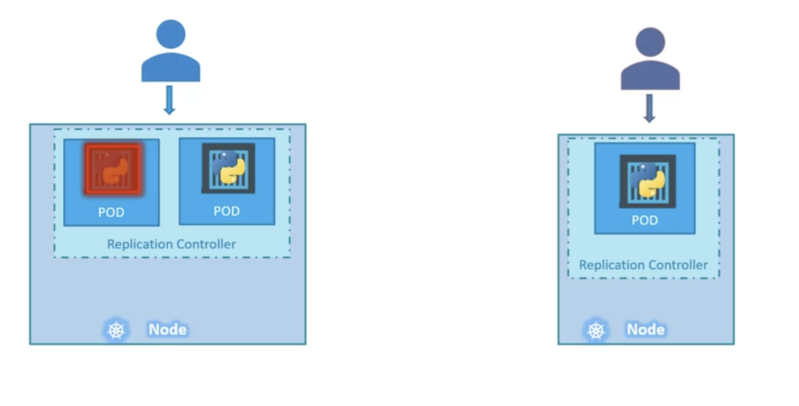
Replication controller – HA/Fault tolerance
Controllers:
Brain behind k8s
Monitor k8s and act accordingly
Replication controller provides:
HA

Slide 21
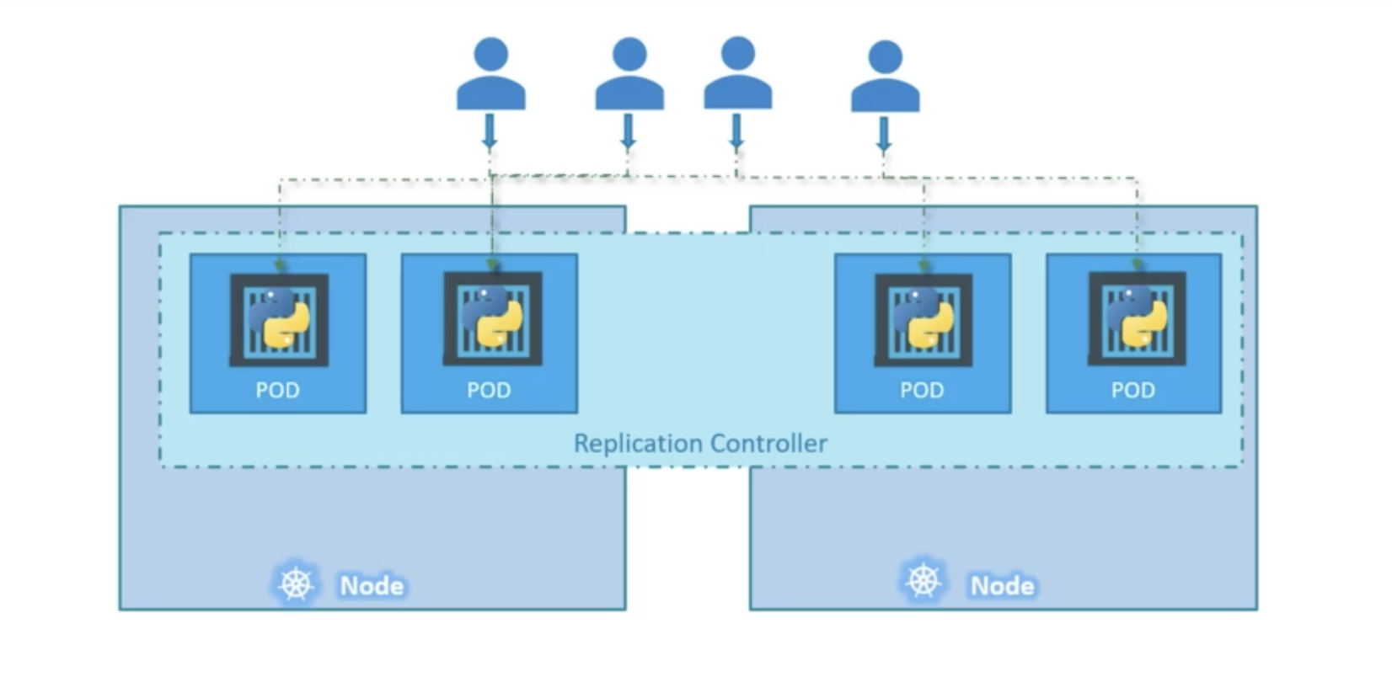
Replication Controller – Load Balancing
Load Balancing can span across nodes

Slide 22
Replication controller vs Replica set
Replica set is the new recommended way

Slide 23
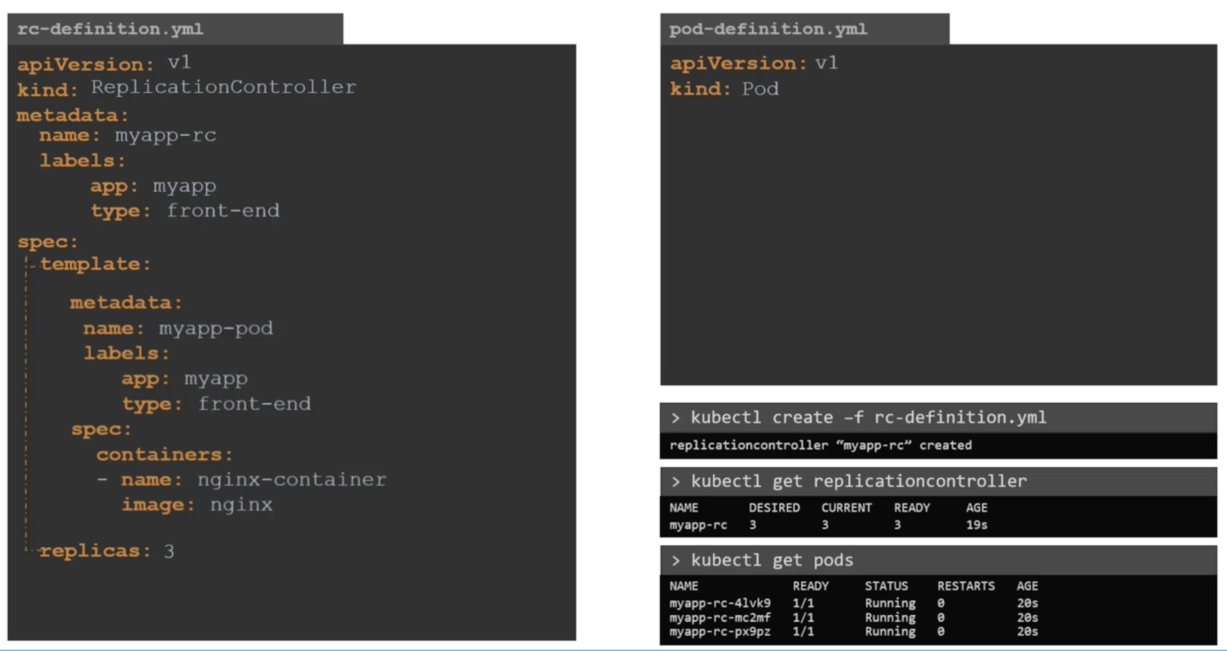
Create replication controller (old way)
It’s like ASG – you provide a template and number of replicas

Slide 24
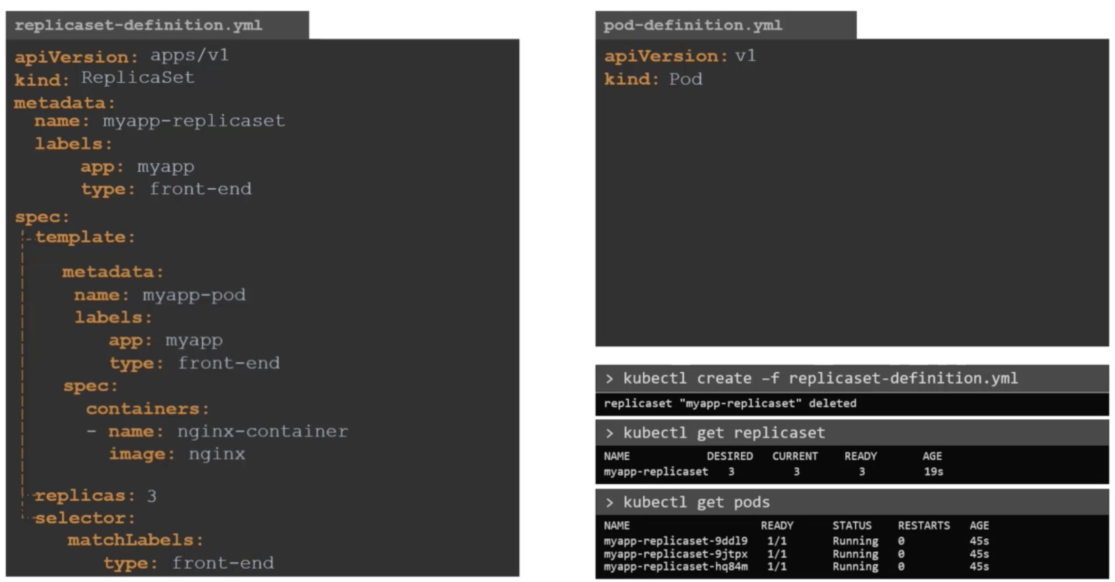
Create replica set (recommended way)
Same as replication controllers but have selectors (can be used to monitor existing pods specified in label filter)

Slide 25
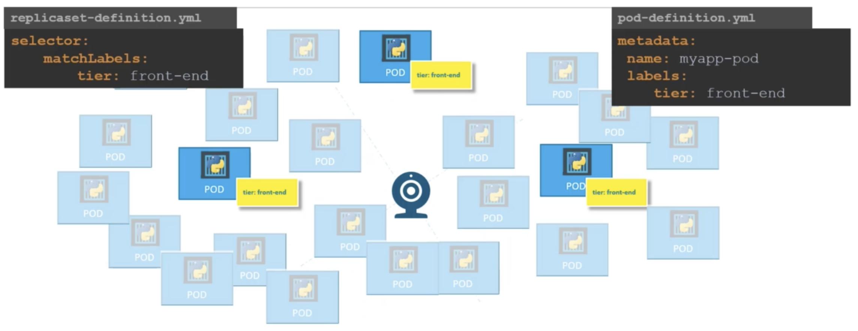
Label filtering
Example shows replica set monitoring pods labeled as ‘front end’

Slide 26
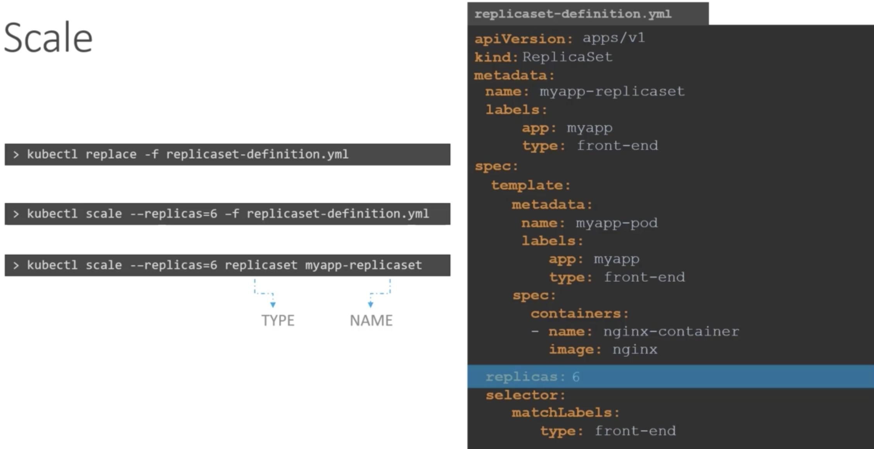
Replica set
Template definition needed even if pods specified in filter already exist
Scaling:

Slide 27
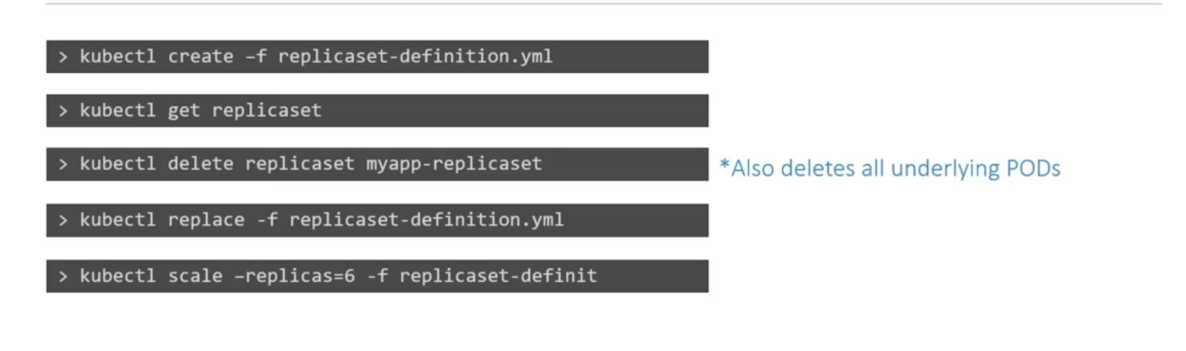
Replica set commands

Slide 28
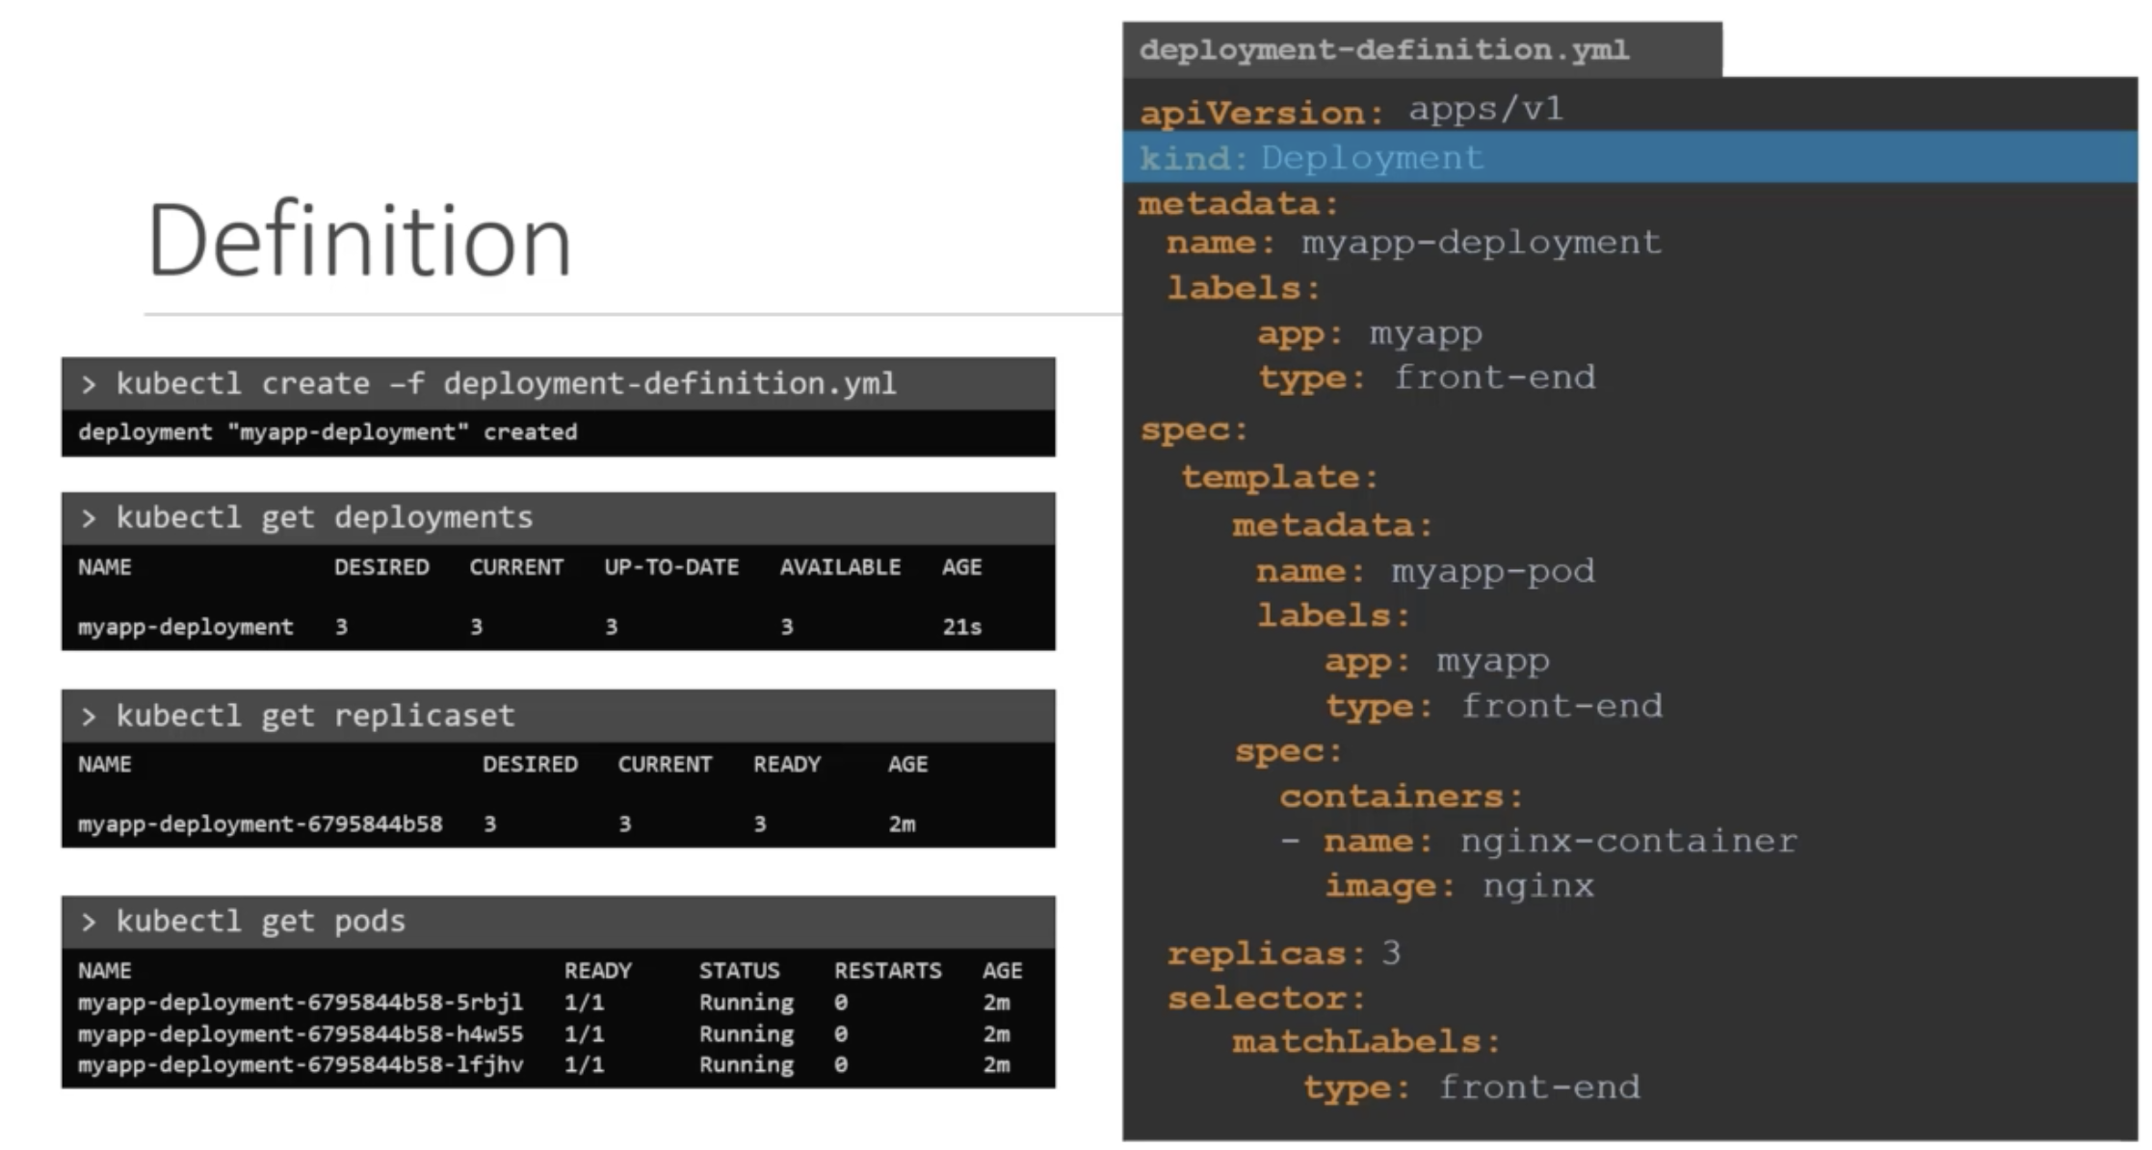
Deployments
Very similar to replicasets:

Slide 29
Quick commands (without definition file)
Create an NGINX Pod
kubectl run --generator=run-pod/v1 nginx --image=nginx
Generate POD Manifest YAML file (-o yaml). Don't create it(--dry-run)
kubectl run --generator=run-pod/v1 nginx --image=nginx --dry-run -o yaml
Create a deployment
kubectl run --generator=deployment/v1beta1 nginx --image=nginx
Or the newer recommended way:
kubectl create deployment --image=nginx nginx

Slide 30
Generate Deployment YAML file (-o yaml). Don't create it(--dry-run)
kubectl run --generator=deployment/v1beta1 nginx --image=nginx --dry-run -o yaml
Or
kubectl create deployment --image=nginx nginx --dry-run -o yaml
Generate Deployment YAML file (-o yaml). Don't create it(--dry-run) with 4 Replicas (--replicas=4)
kubectl run --generator=deployment/v1beta1 nginx --image=nginx --dry-run --replicas=4 -o yaml
kubectl create deployment does not have a --replicas option. You could first create it and then scale it using the kubectl scale command.

Slide 31
Save it to a file - (If you need to modify or add some other details)
kubectl run --generator=deployment/v1beta1 nginx --image=nginx --dry-run --replicas=4 -o yaml > nginx-deployment.yaml
Create a Service named nginx of type NodePort and expose it on port 30080 on the nodes:
kubectl create service nodeport nginx --tcp=80:80 --node-port=30080 --dry-run -o yaml
Reference:
https://kubernetes.io/docs/reference/kubectl/conventions/

Slide 32
kubectl run --generator=deployment/v1beta1 webapp --image=kodekloud/webapp-color --replicas=3
kubectl expose deployment webapp --type=NodePort --port=8080 --name=webapp-service --dry-run -o yaml > webapp-service.yaml
https://kubernetes.io/docs/reference/kubectl/conventions/

Slide 33
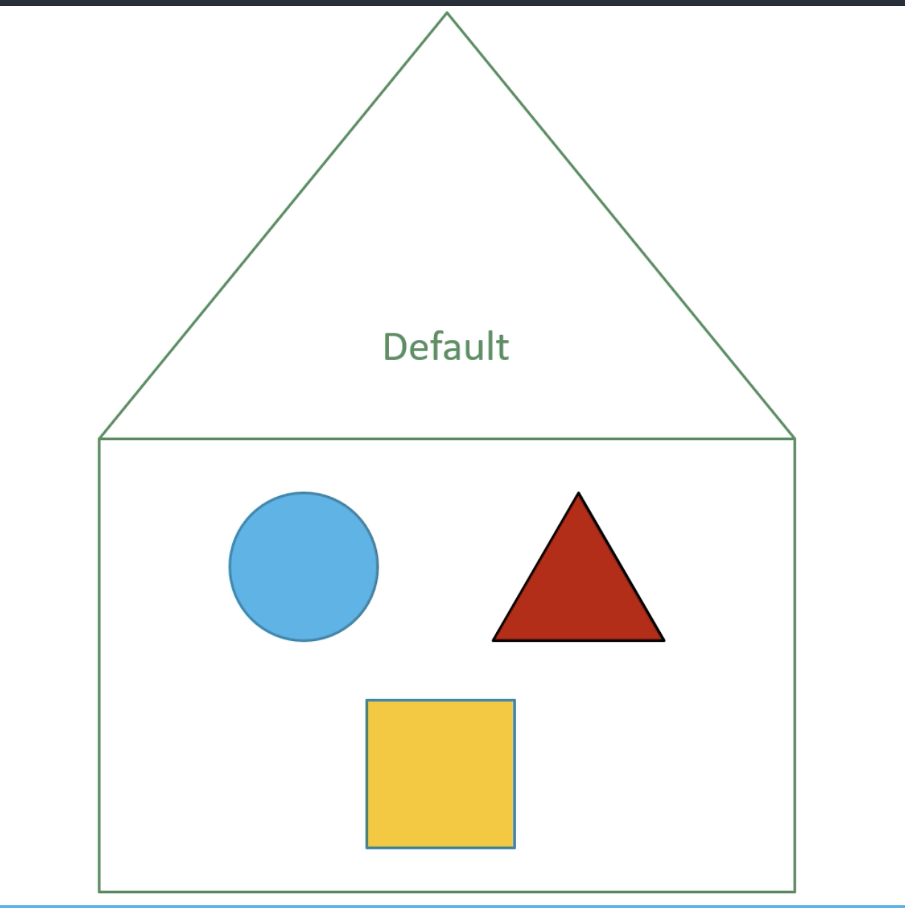
Namespaces
Default namespace (or a house) is created automatically
Kube-system – host k8s services e.g. DNS
Kube-public – public resources
Needed in enterprize –
for e.g. dev or prod namespace

Slide 34
Namespaces
Each namespace can be assigned policies to control who can do what and also add resource limits
Local resources in namespace can be called directly with the name

Slide 35
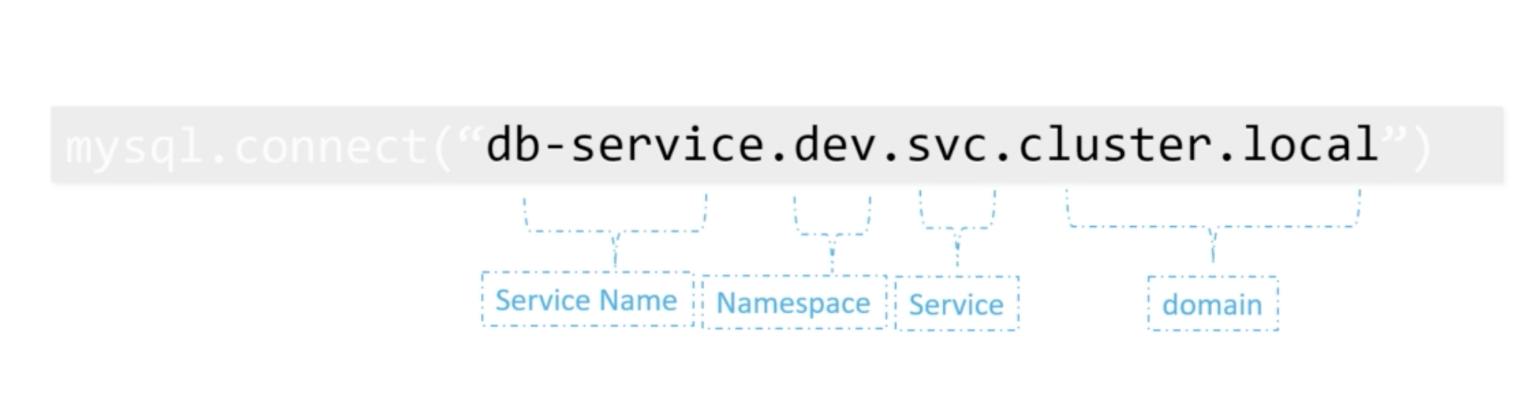
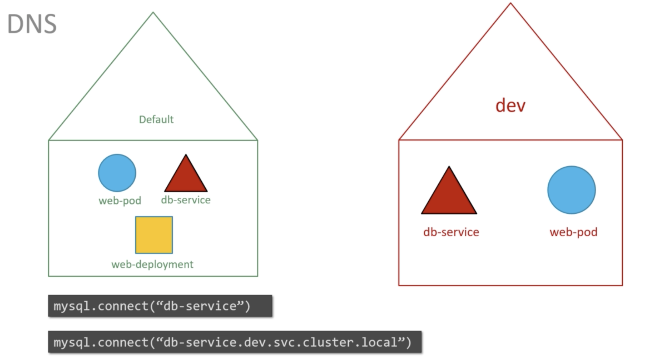
Namespace
Cross namespace access example –

Slide 36
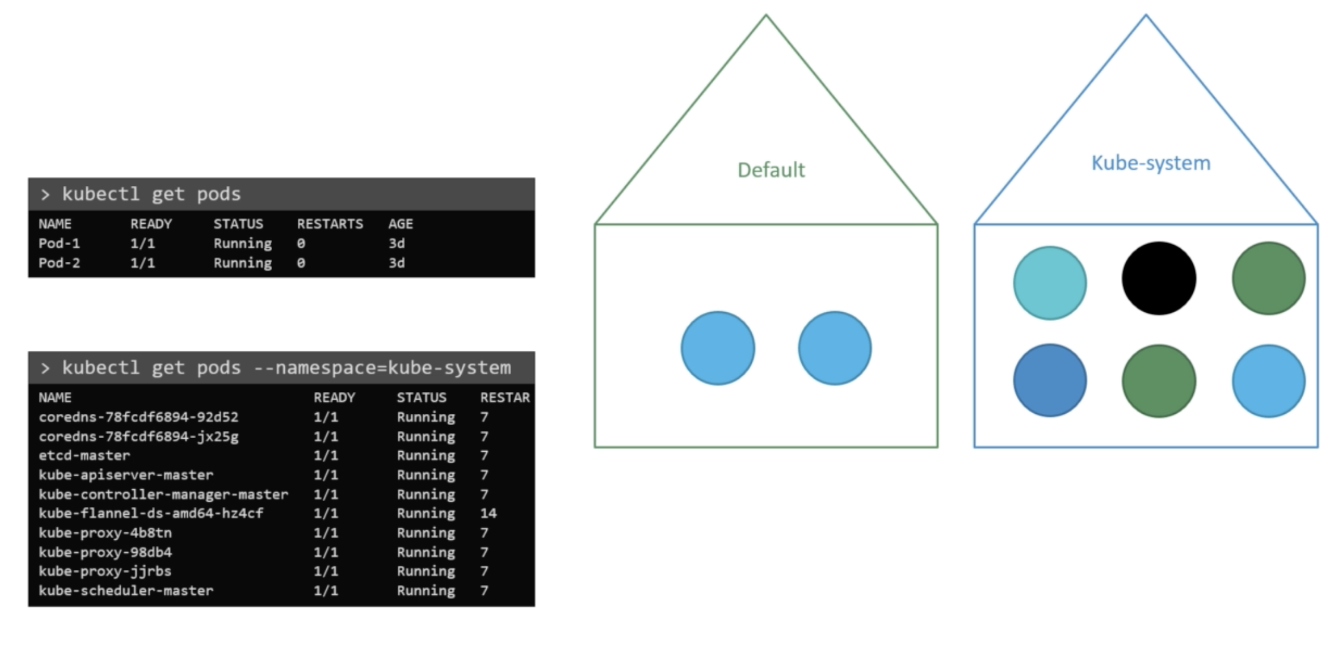
Namespace - commands

Slide 37
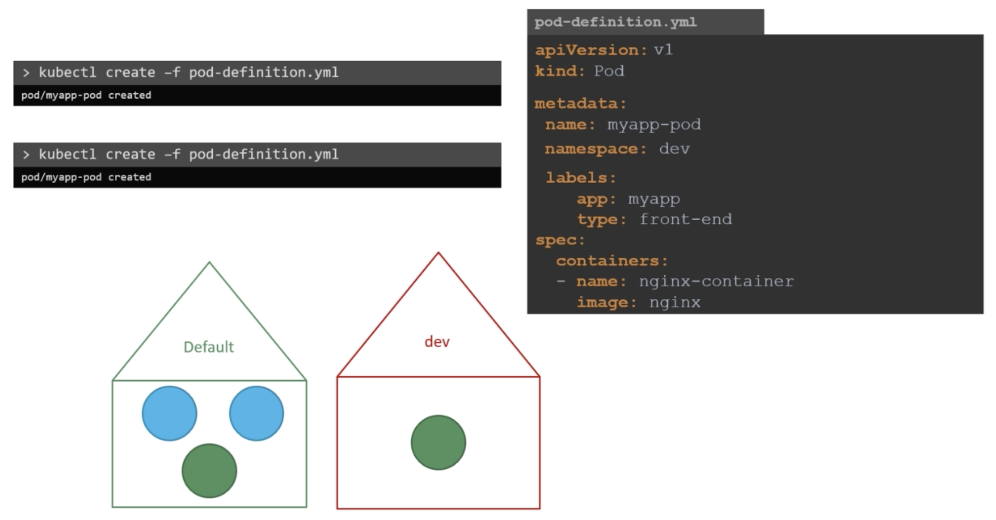
Create POD in namespace

Slide 38
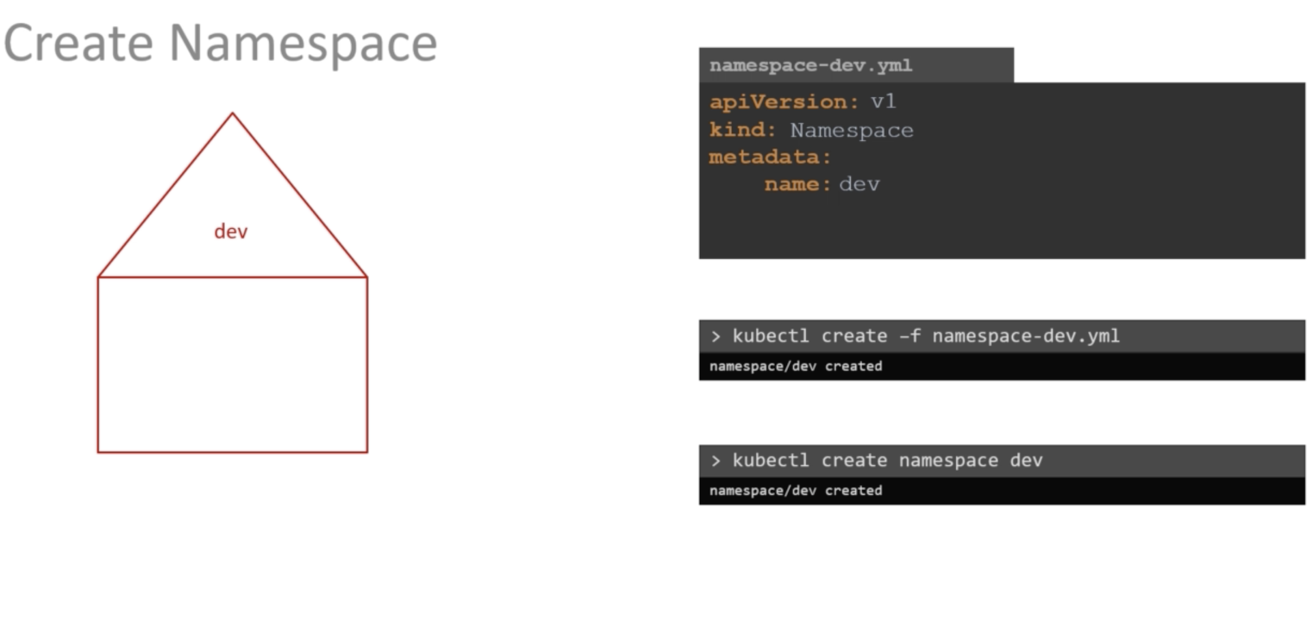
Create namespace

Slide 39
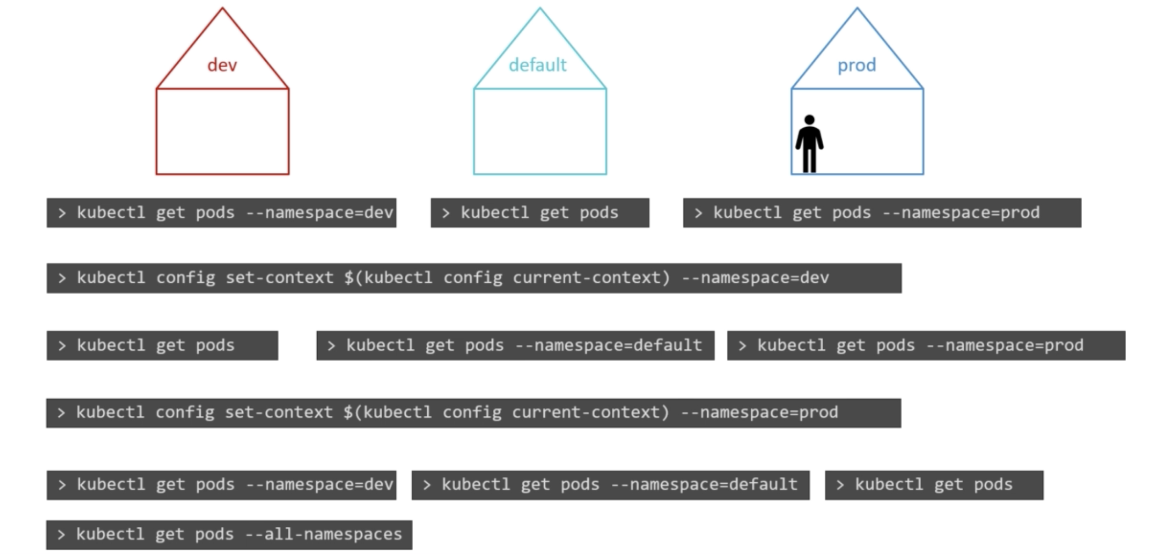
Switch namespace context

Slide 40
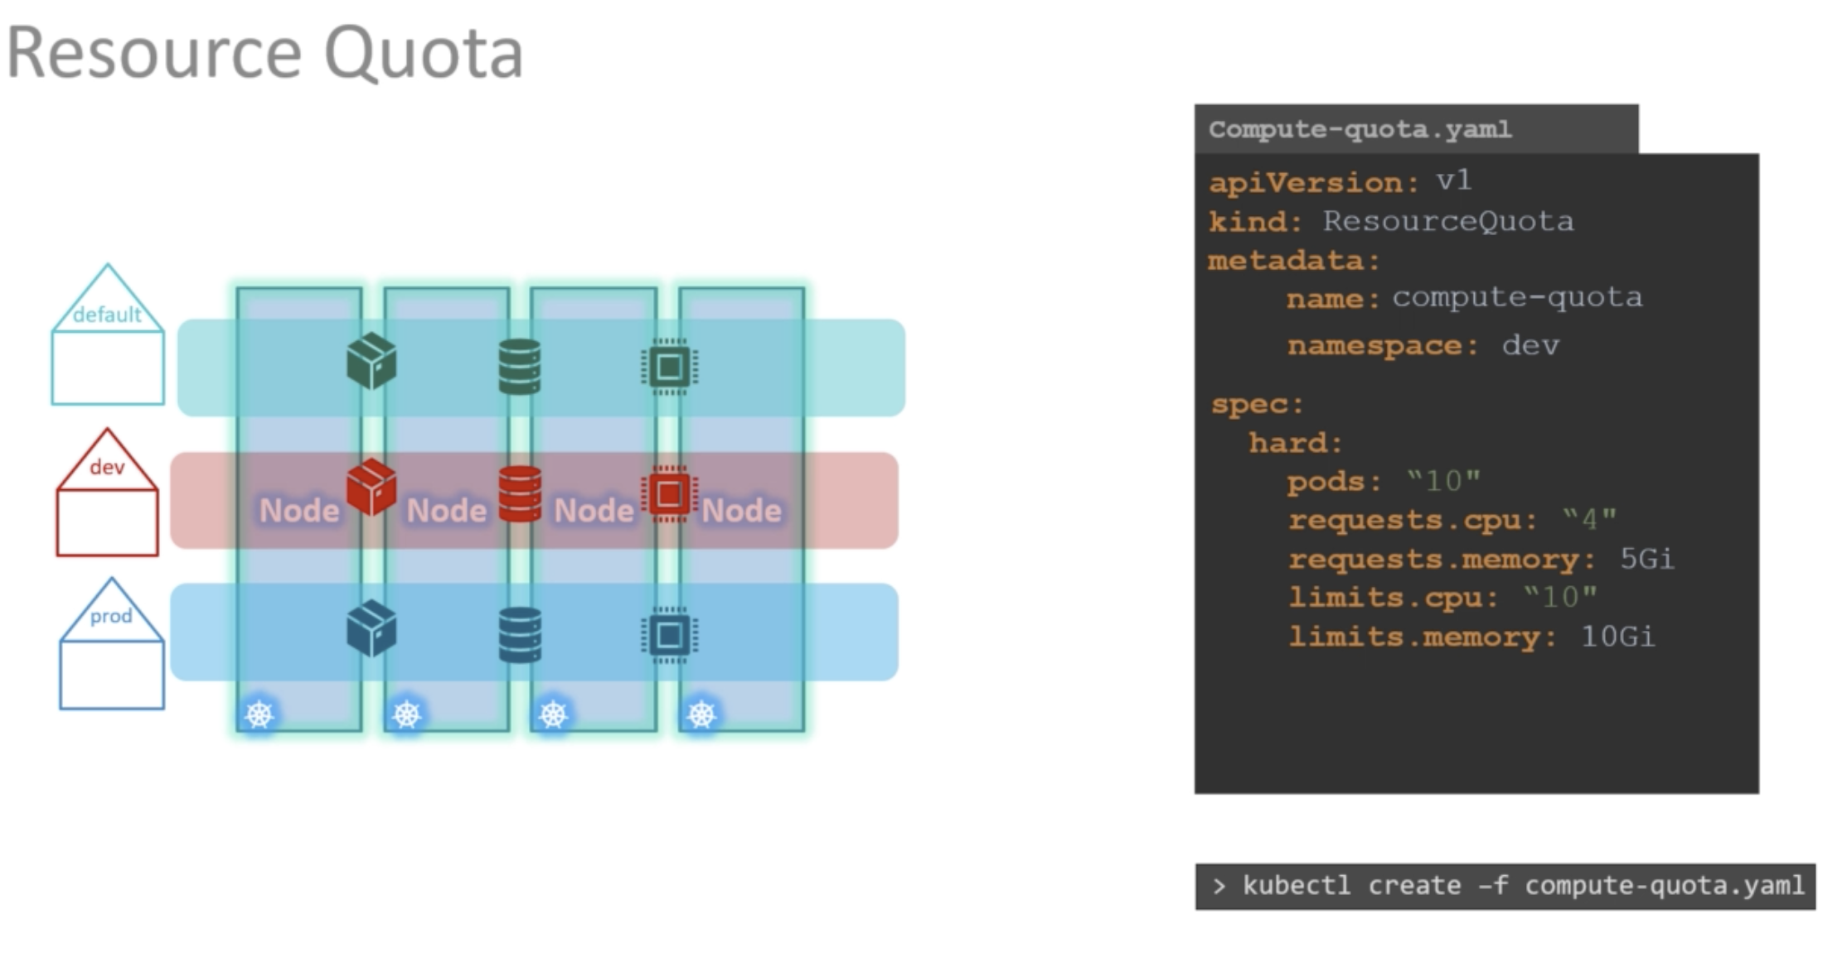
Resource quota
K8s object type

